Slide 1
Developing & Improving
Meaningful Program
Learning Outcomes
Assessment Breakfast Presentation & Workshop
Sponsored by ACERT & the Office of Assessment – November 6, 2019
Joel D. Bloom, Director of Assessment
joel.bloom@hunter.cuny.edu

Slide 2
“Teaching, Learning, & Assessment as a Continuous Four-Step Cycle” (Suskie, 2018)
Establish Learning Goals
Provide Learning Oppor-tunities
Assess Student Learning
Use the Results

Slide 3

But where do the Goals Come From?

Slide 4
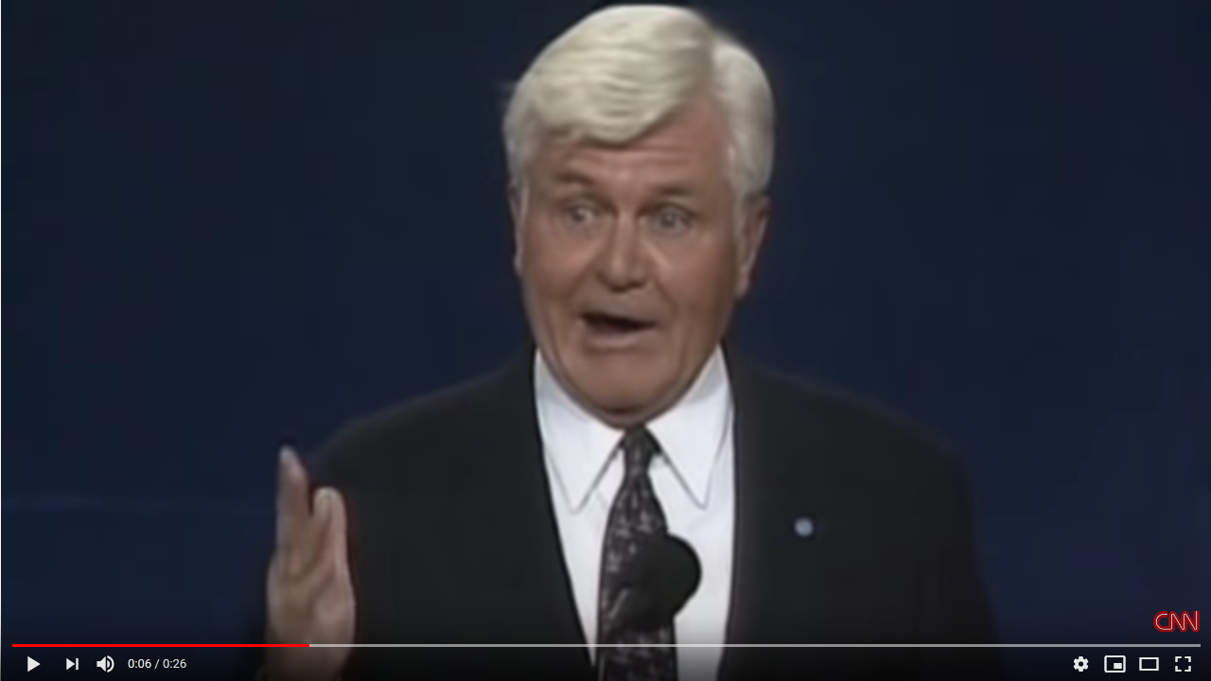
Admiral John Stockdale
Vice Presidential Debate, 1992
Who am I? Why am I here?

Slide 5
Assessment & Values (Banta et al., 1996)
“Assessment has the greatest chance for success when it is based on educational values. This means that for assessment to be truly effective – from an institutional perspective – in improving that which is important, institutional agents including trustees, administrators, faculty, staff, students, and outside publics must first have a shared conception as to what the institution is, what it values, and what it aspires to be.”
Banta, Lund, Black, and Oblander, Assessment in Practice: Putting Principles to Work on College Campuses. Jossey-Bass, 1996.

Slide 6
What I mean by Values-Centered Assessment:
What do you really care about?
What brought you to higher education in the first place?
Why did you choose your field/specialization?
  What really excites you about your field?
  What would you be devastated about if a student graduated from your program without understanding?
What makes your department/program/unit different than others in your field?
  Methodological, Epistemological or Ideological Approaches
  Subfield Focus
  Philosophy of Teaching, etc.

Slide 7
The role of assessment in higher education is:
To tell us the extent to which we are doing the things we really care about…
  As reflected in our learning outcomes!
To tell us if our students are really learning the things we want them to learn.
To provide us with useable information (a.k.a. actionable data) to help us do all these things we care about even better than we’re doing it now.

Slide 8
Don’t do assessment to satisfy anyone else’s goals or requirements.
Do assessment that will help you and your program achieve the things you care about the most.
To do that, you need:
  Program learning outcomes that actually reflect the things you care about the most, and
  Precise information on what your students are learning with regard to those outcomes.

Slide 9
The Point Is:
Are you measuring something you really care about?
Do the results matter to you?
What will you do with the results once you get them?

Slide 10
“Teaching, Learning, & Assessment as a Continuous Four-Step Cycle” (Suskie, 2018)
Establish Learning Goals
Provide Learning Oppor-tunities
Assess Student Learning
Use the Results

Slide 11
The Assessment Cycle: It Starts with Values
Outcomes
Assess-ment
Reflection & Analysis
Curriculum Revision
Goals & Strategic Priorities
Curriculum Design
Teaching & Learning
Values
Mission

Slide 12
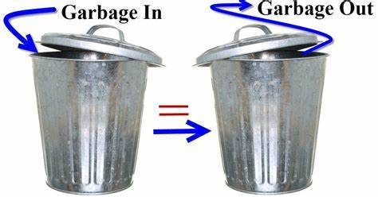
The Problem With Bad SLOs:
Even if you do a “valid” assessment, you don’t learn anything useful!

Slide 13
Reasons to Update Your PLOs
New developments in the field necessitate rethinking the curriculum
Faculty turnover → changes in focus of the department & major
Recent assessments suggest different or revised areas of focus
Recent assessments haven’t given you useful information
  Old PLOs are too few/vague or too specific/numerous

Slide 14
How to Implement
Values-Based Assessment
Articulate your values (consistent with your mission – which might require some serious revision!)
  Institutional Values (including general education)
  Program/Unit Values
Align: Create SLOs (Student Learning Outcomes) based on those values
Advertise: Put those values & SLOs front and center in:
  Web pages, Department meetings, Curriculum revisions, Curriculum maps, Catalogue, Syllabi, Advisement!!!
Assess: Design, administer, & analyze assessments carefully aligned with values & SLOs
Share the results with your faculty & your students!

Slide 15
Examples: Values-Free or
Values-Challenged Programs
My major department at my alma mater, then (1986) and now:
  Only discernable published values or SLOs are distribution of courses among subfields & course levels.
A dept. in the sciences at my previous employer. MS PLO:
  “Students will demonstrate either an ability to conduct supervised research or an advanced mastery of basic concepts.”
A dept. in the social sciences:
  PLOs & Ph.D. graduate student manual: research methods requirement can be met through competency in either quantitative or qualitative.
  But they failed students without quantitative competency even if they demonstrated qualitative competency!

Slide 16
Resources on Creating PLOs
From the Hunter Assessment web page:
  http://www.hunter.cuny.edu/academicassessment/HowTo/AssessMyAcadDeptProg/IdentifyPLOs
Ideas for program learning outcomes can come from various sources:
  First and foremost, from collaborative faculty discussion about the program;
  Suggested outcomes provided by professional organizations.
  Complementary departments/programs within the same institution or departments/programs in the same discipline at other institutions.

Slide 17
Resources on Creating PLOs
From the Hunter Assessment web page:
  http://www.hunter.cuny.edu/academicassessment/HowTo/AssessMyAcadDeptProg/IdentifyPLOs
Effective program learning outcomes:
  Are about what students have learned, not what we want to teach them.
  Are based on program values.
  Describe students' knowledge, skills, and capabilities upon completion of the program
  Specify ~three to seven program learning outcomes that can be observed and measured
    No magic number, but 1-2 are too few, and 8 or more would be pretty ungainly to assess within a reasonable cycle.
  Align with a course learning outcomes (CLOs) in at least 2 courses at different levels, as shown in your curriculum map.
  Align with institutional learning outcomes (ILOs) where relevant

Slide 18
Activity: Articulating Values,
Creating Values-Centered SLOs
Thinking of the institution where you studied as an undergrad:
  Take five minutes to think of (and write down):
    1-2 institutional values
    1-2 institutional learning outcomes based on those values
  Take five minutes to think of (and write down):
    1-2 program values in your major
    1-2 program learning outcomes based on those values
  Take five minutes to discuss the values & SLOs you wrote down with 1-3 people sitting near you.
  We’ll then take 5 minutes to hear some examples from the group.
  How might the implementation of values-centered assessment transform your institution or your program?

Slide 19
Characteristics of Effective Learning Goals (Suskie, 1998, pp. 46-50)
Describe outcomes, not learning content, products, or activities
Clarify fuzzy terms
Use concrete, observable action verbs when possible
Be rigorous, yet realistic
Be neither too broad nor too specific
Use compound statements judiciously
Limit your goals

Slide 20
Resources for Identifying Learning Goals
(Suskie, 1998, pp. 51-52)
Internal Resources
  Your college’s (or program’s) mission statement, vision statement, and strategic goals
  Syllabi of current courses, especially capstones
External Resources
  Goals or standards espoused by relevant disciplinary associations & accreditors
  Surveys or interviews of prospective employers of graduates of your program
  Admissions criteria for graduate programs your students are applying for
  LEAP Essential Learning Outcomes (www.aacu.org/leap/essential-learning-outcomes)
  The Degree Qualifications Profile (www.degreeprofile.org)
  Taxonomies for learning goals
  Google searches of learning outcomes for peer programs.

Slide 21
Assessment Words:
You can find numerous lists of good words to use in student learning outcomes and rubric design. Here is one frequently used list, along with an “objectives builder:”
https://www.clinton.edu/curriculumcommittee/listofmeasurableverbs.cxml
https://teachonline.asu.edu/objectives-builder/

Slide 22
Questions, Comments, Contact
Joel D. Bloom
joel.bloom@hunter.cuny.edu

