Slide 1
Today:
Finish Chapter 20 (Sound)
Chapter 22 (Electrostatics)
Reminder: Nov 18th is 2nd midterm,
Chs. 9, 11, 13, 14, 15, 19, 20, 22

Slide 2
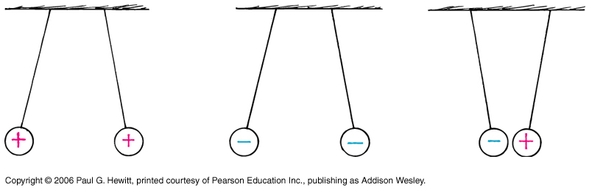
Electrical Force: Coulomb’s Law
Charged particles exert forces on one another :
Like charges repel each other
Unlike charges attract
Acts along a line connecting the charges
Determined by Coulomb’s Law (18th century):
C = Coulomb, unit of charge q (more next slide)
q₁q₂
k = 9 x 10⁹ N m²/C²
F = k
d²
d = separation
c.f. Newton’s gravitational law
-- Inverse-square dependence on separation
-- proportional to size of each charge - c.f. grav. law (prop to each mass)
-- BUT k >> G; the electrical force is much stronger than gravitational force
--- Also, elec. force can be either attractive or repulsive, grav. force always attractive

Slide 3
Charge
Fundamental quantity in all electrical phenomena: positive and negative particles carry “charge”
Recall, protons
electrons
Attractive force btn protons and electrons cause them to form atoms, as we saw in Ch.11.
Electrical force is behind all of how atoms bond i.e. behind chemistry…
Every electron has charge -1.6 x 10⁻¹⁹ C, and every proton 1.6 x 10⁻¹⁹ C
    i.e. -1 C represents the charge of 6.25 billion billion electrons !
    Yet 1C is the amount of charge passing through a 100-W light bulb in just over a second. A lot of electrons!
Charge is always conserved: charge cannot be created or destroyed, but can be transferred from one object to another.
Eg. Rubbing a rod with fur – electrons transfer from fur to rod, leaving rod negatively charged, and fur with exactly same magnitude of positive charge.

Slide 4
More on charge
Note that in everyday charging processes (like rubbing objects), it is the electrons that transfer (not the protons). A negatively charged object has an excess of e’s, whereas positively charged one has deficiency (by same amount)
Which object gains the electrons depends on their electron affinity:
Eg. Rod has greater affinity than fur, so rod becomes –, fur +
Eg. Silk has greater affinity than rod → when rubbed together, rod becomes +, silk -
Eg. Combing hair → Comb becomes –, hair + (e’s go from hair to comb)
Charge is quantized: cannot divide up charge into smaller units than that of electron (or proton) i.e. all objects have a charge that is a whole-number multiple of charge of a single e.

Slide 5
Question
Compare the gravitational force between an electron and proton in an H atom with the electrical force between them. Use:
Average radius of H atom = 0.5 x 10⁻¹⁰ m
Mass of proton = 1.67 x 10⁻²⁷ kg
Mass of electron = proton mass/2000 = 8.35 x 10⁻³¹ kg
Felec = kq_{e}q_{p}/d²
= (9x10⁹)(1.6 x 10⁻¹⁹)(1.6 x 10⁻¹⁹)/(0.5x10⁻¹⁰)²
= 9.2 x 10⁻⁸ N
Fgrav = Gm₁m₂/d²
=(6.67 x 10⁻¹¹)(1.67 x 10⁻²⁷)(8.35 x 10⁻³¹ kg)/(0.5x10⁻¹⁰)²
= 3.7 x 10⁻⁴⁷ N -- far smaller!

Slide 6
Clicker Question
So the electrical attraction is by far dominant in providing the centripetal force that keeps the electron in orbit around the proton. How about the force the electron exerts on the proton?
it’s larger than the force on the electron
It’s the same
It’s smaller
It depends
Answer: B, Newton’s 3rd law
The electrical force is an interaction (as any force is) and each pulls on the other equally. As always, distinguish the effect of the force from the force itself: due to the proton’s mass being 2000 x that of the electron’s it is the electron that rotates around the proton due to this force, rather then both of them rotating about each other…

Slide 7

Clicker Question
What is the ratio of the force on the electron in an ionized He atom, i.e. He⁺, to that on the electron in a H atom, if the average distance to the nucleus in He ion is ¾ of that in the H atom?
(Note that He has atomic number of 2)
32/9
8/3
4/3
16/9
None of the above
Answer: A
Force = kq₁q₂/d²
For He⁺ one of the charges is doubled compared with H atom, while d is ¾ as much. So Force is $\frac{2}{{(3/4)}^{2} }$ = 2*16/9 = 32/9 as much.

Slide 8
Conductors and Insulators
How easy is it to get an electric current to flow across a material? Property called electrical conductivity.
Depends on how strongly the electrons are anchored to the nuclei:
Good conductor: e.g. metal. Electrons freely wander in the material, they are “loose”. Good conductors of electrical current are also good heat conductors.
Good insulator: e.g. rubber, glass, wood. Electrons tightly bound to nuclei, so hard to make them flow. Hence, poor conductors of current and of heat.
Electrical resistivity – quantifies how much a material resists current flow.
Insulator has very high resistance (or resistivity), conductor very low. There is a range, depending on the material.
(More on this in Ch 23)

Slide 9
Semiconductors
Materials that can be made to behave sometimes as insulators, sometimes as conductors.
E.g. Germanium, silicon. In pure crystalline form, are insulators. But if replace even one atom in 10 million with an impurity atom (i.e. a different type of atom that has a different # of electrons in their outer shell), it becomes an excellent conductor.
Transistors: thin layers of semiconducting materials joined together.
Used to control flow of currents, detect and amplify radio signals, act as digital switches…An integrated circuit contains many transistors.
Light can cause conduction in semiconductors:
E.g. In the dark, selenium is a good insulator, can hold electric charge for long time. But if shine light on it, charge quickly leaks away to surroundings.
This is the basis of xerox machines! Black plastic powder sticks only to the charged areas which have not been exposed to light – hence reproduces pattern of the light.

Slide 10
Superconductors
Have zero resistance, infinite conductivity below a critical temperature
Not common! Have to cool to very very low temperatures.
Current passes without losing energy, no heat loss.
Discovered in 1911 in metals near absolute zero (recall this is 0ºK, -273ºC)
Discovered in 1987 in non-metallic compound (ceramic) at “high” temperature around 100 K, (-173ºC)
Under intense research! Many useful applications eg transmission of power without loss, magnetically-levitated trains…

Slide 11
Charging
(1) Charging by friction and contact
Already discussed (rubbing materials together, see earlier slide on charge).
Often can see or hear the sparks when the charges move.
eg. Walk across a rug – feel tingle when touch door knob: electrons transferred from rug to your feet, then to the door knob.
charging by friction
charging by contact – simply touch

Slide 12
Clicker Question
Consider a negatively charged rod that touches a long conductor, transferring its charge to the conductor. What is the difference between how the electrons become arranged on the conductor, versus how they would be arranged if it had been an insulator?
There is no difference – evenly distributed on both
There is no difference – localized on both, near the contact point with the rod.
They are evenly distributed on the conductor, but localized on the insulator near the contact point with the rod
They are evenly distributed on the insulator, but localized on the conductor near the contact point with the rod
Answer: C
Would spread out evenly on a good conductor, because the transferred e’s repel each other. But on insulator, or poor conductor, would be more localized at where the rod touched.

Slide 13
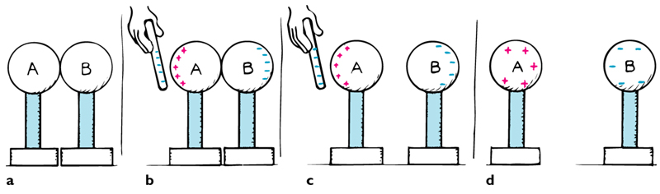
(2) Charging by induction
Bring a charged object near a conducting surface, electrons will move in conductor even though no physical contact: Due to attraction or repulsion of electrons in conductor to the charged object – since free to move, they will!
Charge redistribution until forces between all charges balance to 0.
Then if you separate parts of conductor – they will be charged.
Eg. Here, in (b), e’s in A-B repelled away from rod, so get excess on B, leaving A positively charged:
Note, the charged rod never touched them, and retains its original charge.
Question: Must the resulting charges on spheres A and B be equal and opposite?
Yes, because each + charge on A is from an electron leaving it and moving to B. Charge is conserved – no charge is added from rod as no contact.

Slide 14
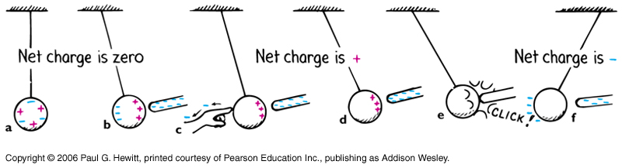
Charging by induction continued…
Charge induction by grounding: Here, can induce charge on a single neutral sphere hanging from a non-conducting string:
Here, charge redistributes, but net charge on sphere still 0
…so that here, sphere is left +.
Remove rod:
Steps a-d yield a +charged sphere.
When touch with finger, electrons flow from your finger, through you, to the ground. The earth is a huge reservoir of charge... (More in Ch 23)
If touch rod to sphere, get charging by contact – electrons flow onto sphere.
Remove rod:
Steps a-f yield a -charged sphere.

Slide 15
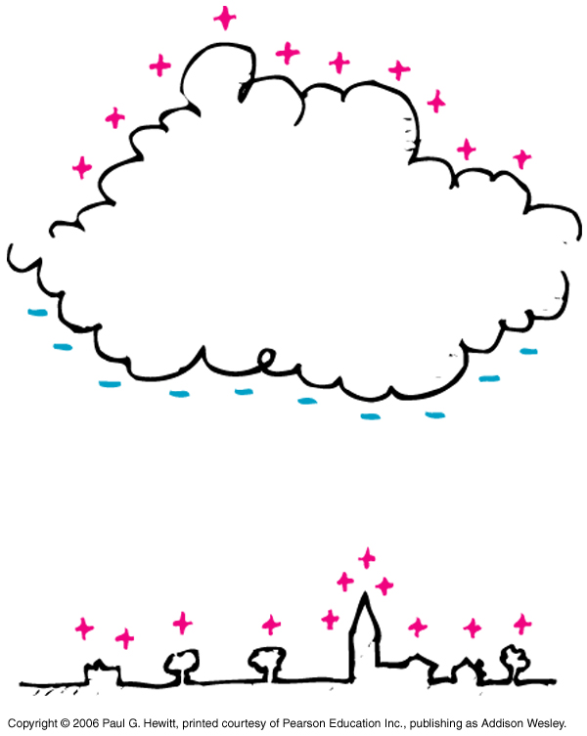
Eg Thunderstorms
Negative charge at bottom of cloud induces positive charge on ground below.
Charge flows most readily to and fro sharp metal points -hence lightning rods.
Place rod above a building, and connect it to ground. Then the point of the rod picks up e’s from the air, so prevents large build up of + on the building, hence decreasing chance of a lightning strike.
But even if there is a lightning strike, the electricity goes through rod to ground, rather than through building.

Slide 16
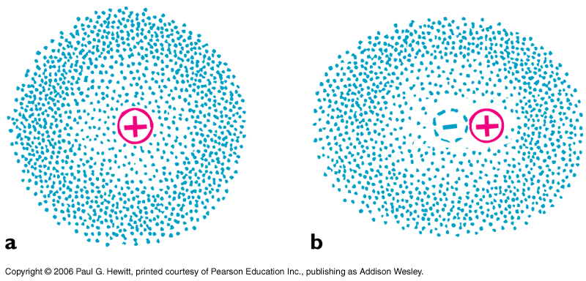
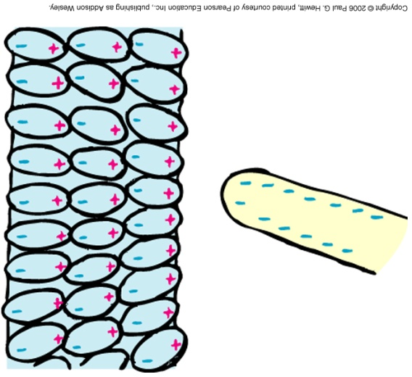
Charge polarization
Instead, if bring a charged object near an insulator, electrons are not free to migrate throughout material. Instead, they redistribute within the atoms/molecules themselves: their “centers of charge” move
Here, usual atom, with center of electron cloud at positive nucleus
When a –ve charge is brought near the right, electron cloud shifts to the left. Centers of + and – charges no longer coincide.
Atom is electrically polarized
Surfaces of material look like this. A – charge induced on left, and + on the right.
(Zero net charge on whole object)
Notes:
Start here Tues

Slide 17
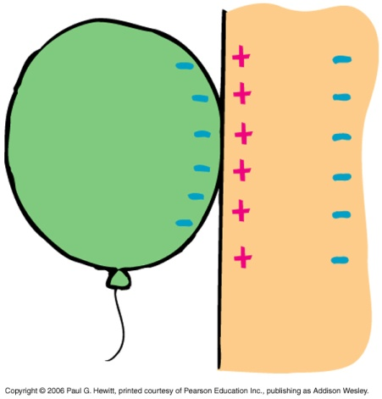
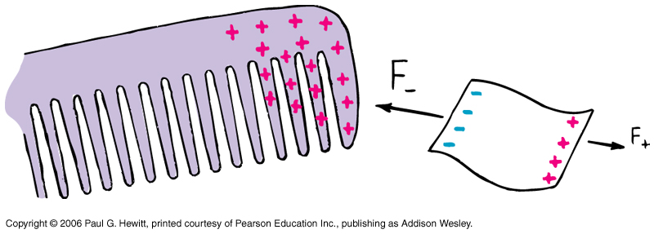
Charge polarization continued
Charge polarization is why a charged object can attract a neutral one :
DEMO: Rub balloon on your hair – it will then stick to the wall !
Why?
Balloon becomes charged (by friction) when rub on hair, picking up electrons. It then induces opposite charge on the wall’s surface closest to it (+ve), and the same charge as itself (-) on side of wall furthest away.
So balloon is attracted to + charges and repelled by – charges in wall – but the – charges are further away so repulsive force is weaker and attraction wins.
(Argument applies generally – key thing is difference in distance btn + and -)
Eg. Charge a comb by rubbing it through your hair, and then see it attracts bits of paper and fluff…

Slide 18
Clicker question
Which of the following is true?
A positively charged object can attract only a negatively charged object
A positively charged object can attract a negatively charged object or a neutral object
A positively charged object can attract a negatively charged object, a positively charged object, or a neutral object.
A positively charged object can attract a negatively charged object, but can repel or attract a neutral object.
Answer: B
Unlike charges attract, but a charged object can attract a neutral one due to polarization

Slide 19
Clicker Question

Slide 20
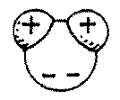
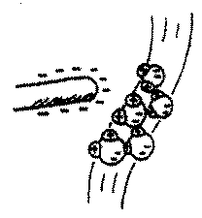
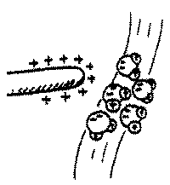
Answer: 2
If you answered 1, you likely thought the bending was due to
positively charged water. But the water normally has no appreciable net charge. The interaction between the charged rod and the water stream is mainly due to the dipole nature of water molecules. H₂O molecules are electric dipoles, positive on the hydrogen side and negative on the oxygen side.
Like compasses that align along a magnetic field, H₂Os align along the electric field of the nearby rod—whether the rod is positive or negative. For both magnets and charges,
the closest aligned pole or charge is always opposite in sign.
Opposites attract, so net attraction is the result.

Slide 21
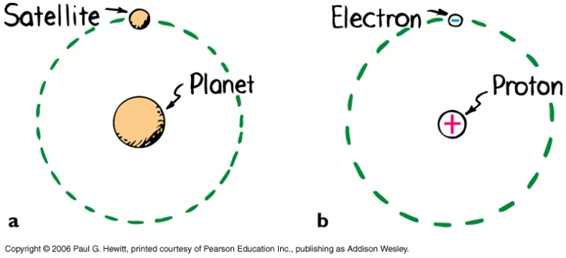
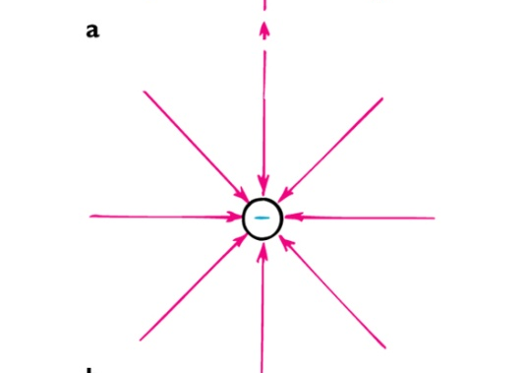
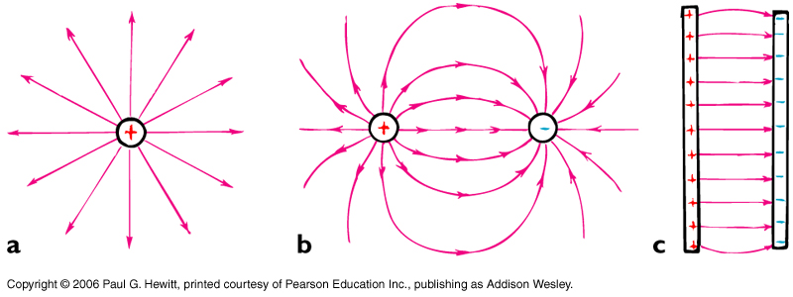
Electric Field
Just like we defined grav field, we’ll define electric field: both forces act on objects they are not in contact with.
The orbiting bodies interact with the force fields (grav for planet, electric for proton).
i.e. think of the force as interaction between one body and field set up by the other.
F
Electric field, E=
Eg. For a – charge:
and for a (larger)
+ charge:
q
And field lines have arrow indicating direction a positive test charge would be pushed.
So always point away from +charges, towards – charges…

Slide 22
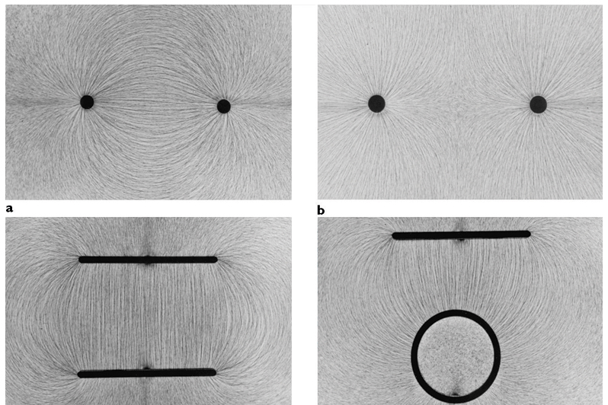
Electric field cont.
Eg. Field for some other charge configurations:
(non-examinable) EXTRA READING:
Equal & opp. charges
Equal and same sign
Eg. Field lines shown by small pieces of thread in an oil bath surrounding charged objects:
Note: Field concept useful when dealing with motion of charges – creates a disturbance of the field that propagates at the speed of light, affecting other charges via this wave (more later..)
Opp. charged plates
Opp charged cyl & plate

Slide 23
Clicker Question
Say the electric field from an isolated point charge has a certain value at a distance of 1m. How will the electric field strength compare at a distance of 2 m from the charge?
It’s the same
It is half as much at a distance 2 m compared to at 1m.
It is ¼ as much
It is twice as much
It is 4x as much
Answer: C
It will be ¼ as much – inverse square law for force between two charges carries over to the electric field from a point charge.

Slide 24
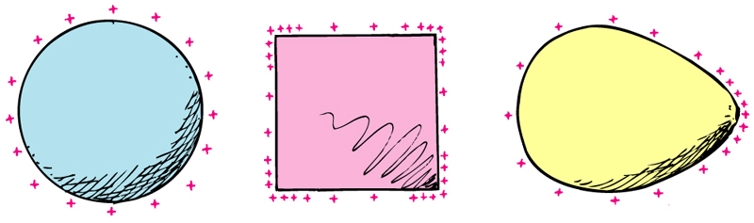
Electrical Shielding
The electric field inside any charged conductor is zero.
The exact charge distribution over the surface is such that E-field inside is 0. If it weren’t, then the free electrons inside would move under the net force, until they feel 0 net force i.e until E-field was 0.
Note, can read in your book for a mathematical explanation of 0 E-field for case of sphere –but actually 0 E-field inside is true generally.
True also for metal cavities - so put electrical equipment in metal boxes. Outside may be very strong fields and high charges, but the charges on the metal surface rearrange to give 0 inside.
More general concept of shielding – air, oil etc makes field between two charges weaker than in vacuum.
Grav fields cannot be shielded (due it purely attractive nature – no repulsion that can cancel fields)
Notes:
Start here Friday

Slide 25
Clicker Question
When lightning strikes a car, it is safe to sit inside it, because
The electric field is zero inside
The electric field is huge but only for a brief time
Nonsense! It is not safe – the electric field is huge inside the car
Answer: A
Electrical shielding…

Slide 26
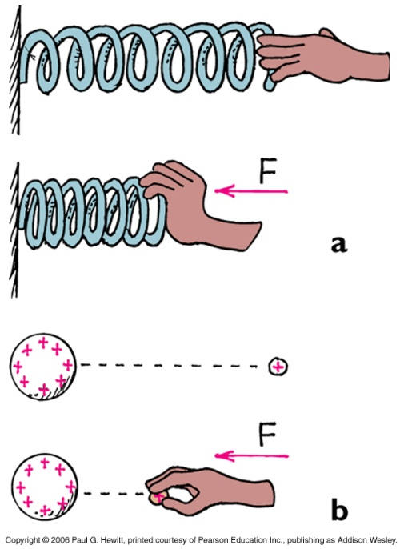
Electric Potential
A charged object has potential energy (PE) from its location in E-field (c.f. grav. PE in Ch. 9)
Work is required to push charge against an E-field – this work changes the electric PE of the charged particle.
Compare with a spring: Do work in pushing it in, this work is stored as mechanical PE of spring.
Similarly, push two like charges together, working against the electrical force, increasing its energy. This work is stored as electrical PE.
If push a particle with twice the charge, do twice as much work.
electric potential energy
So, define electric potential =
charge
Notes:
Start from here Tues Nov 4

Slide 27
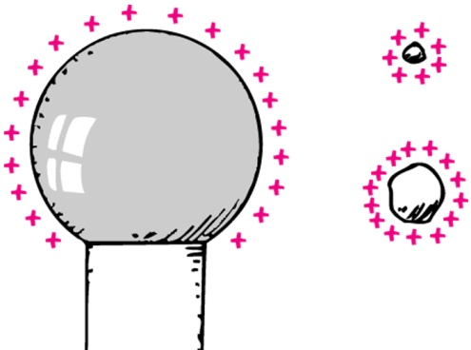
Electric potential cont.
electric potential energy
electric potential =
charge
Units: potential is measured in voltage, or volts, V.
1 volt = 1 Joule/Coulomb
Eg. 12-V battery in your car, means that one terminal is 12 V higher in potential than the other.
Will use terms “electric potential” and “voltage” interchangeably.
Often useful to think of what the electric potential is at various locations without actually having charge there. (See also Ch 23)
Note important difference between energy and potential:
Both the small charged objects are at the same electric potential, but the one with more charge on it has higher electric potential energy.

Slide 28
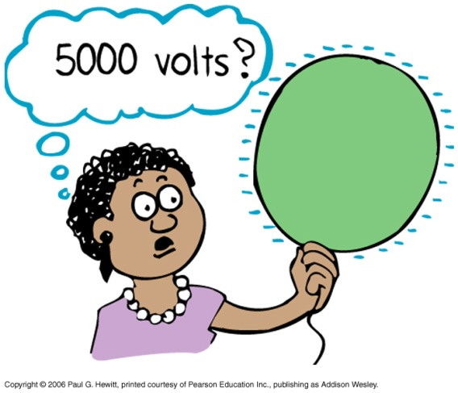
Clicker Question
When you rub a balloon on your hair, the balloon can get charged to about -5000 V. The charge on it is less than a millionth of a Coulomb. Should you be worried about touching it?
A) yes
B) no
Answer: B
No, since very little energy is involved, despite the high voltage.
(If, instead the charge was 1 Coulomb, then it would be 5000J of energy, dangerous)

Slide 29
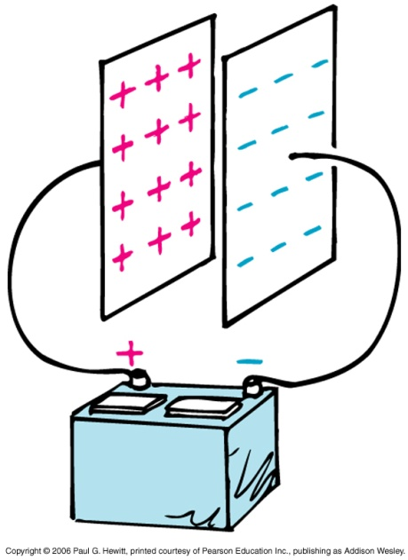
Electrical Energy Storage
Can store electric energy in a capacitor :
Found in nearly all electronic circuits eg in photo-flash units.
Simplest is two close but separated parallel plates. When connected to a battery electrons get transferred from one plate to the other until the potential difference between them = voltage of battery.
( How? Positive battery terminal attracts electrons from LH plate; these are then pumped through battery, through the – terminal to the opposite plate. Process continues until no more pot. diff. btn plate and connected terminal.)
Discharging: when conducting path links the two charged plates. If very high voltages (eg capacitors in tv), its dangerous if you are this path!
e.g. Discharging is what creates the flash in a camera.

Slide 30
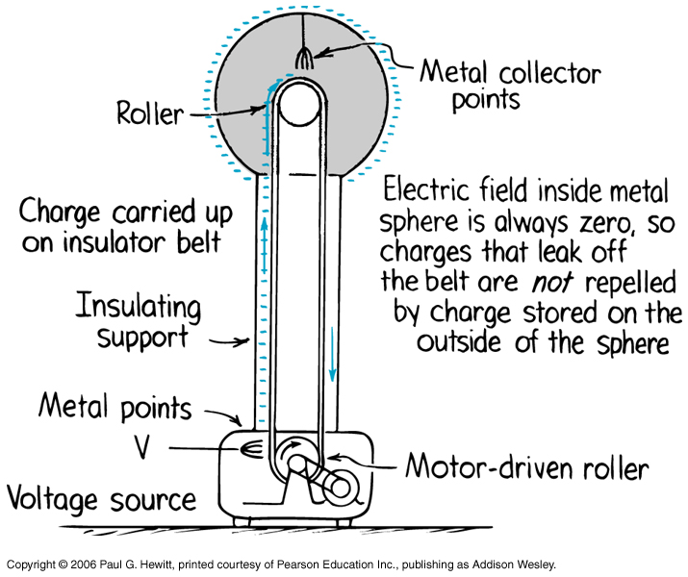
Van de Graaff generator
Is a common device for building up high voltages:
EXTRA READING:
Needles maintained at large negative potential w.r.t. ground. They discharge electrons continuously onto the rubber belt which then carry them up into hollow conductor.
Electrons end up on the outer sphere because there has to be 0 E-field inside – picked up by metal points (acting like lightning rods). Inside remains uncharged so more electrons keep coming up – end up with huge voltage on the dome. Can get as high as 20 million volts!
Can raise your hair with this !! Charges go into your hair, causing hairs to repel each other.

Slide 31
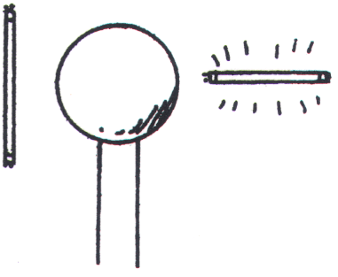
Clicker Question
fluorescent tubes
In next chapter we’ll study how charges tend to move from regions of high potential to low potential.
In which case here does current flow?
In tube on the right: when one end of the fluorescent tube is held closer to the charged Van de Graaff generator
In the tube on the left: when both ends are equidistant
C) In both tubes
D) In neither tube
.
-
-
-
-
-
-
-
-
Answer: A
The close end is in a stronger part of the field than the far end. More energy per charge means more voltage at the near end. With a voltage difference across the tube, you get a current. When both ends are equidistant, there is no voltage difference across the tube, and no current

