Slide 1
Please pick up your midterms from front of class
Average: 70 % Top grade: 92 % ☺
Test % score distribution:
Make sure you go through your test and the solutions carefully to understand where you went wrong.
Ask me at office hours if needed.
I “curve” the final grade (usually higher than midterm), roughly for this exam:
A+ >91, A 82—90, A- 77—81, B+ 72--76, B 65—71, B- 60—64, C+ 55--59,
C 51—54, D 44—50, F < 44

Slide 2
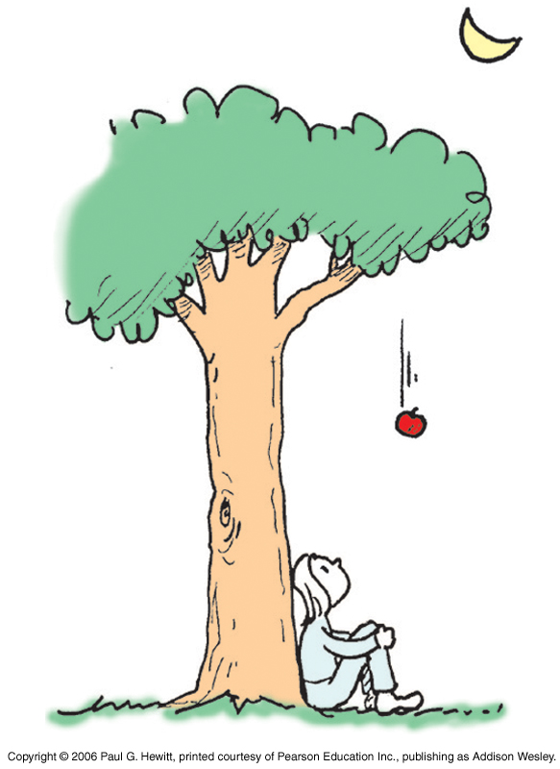
TODAY:
Chapter 9: Gravity
Newton: made the revolutionary connection between the circular motion of celestial bodies and the downward falling of objects on the earth:
It is the one and the same gravitational force responsible for both the apple falling from the tree and the moon orbiting around the earth!

Slide 3
The universal law of gravity (Newton)
Every mass m₁ attracts every other mass m₂ with a force:
m₁ m₂
F ~
d ²
distance between their centers
The greater (either of) the masses, the greater is the attractive force.
The closer they are to each other, the greater the force – with an inverse-square dependence.
The constant of proportionality is called the universal gravitational constant, G = 6.67 x 10 ⁻¹¹ N . m²/kg² = 0.0000000000667 N m²/kg²
Tiny! So gravitational forces between everyday masses at everyday distances (eg you and me) is negligible.
G m₁ m₂
F =
d ²

Slide 4
Clicker Question

Slide 5
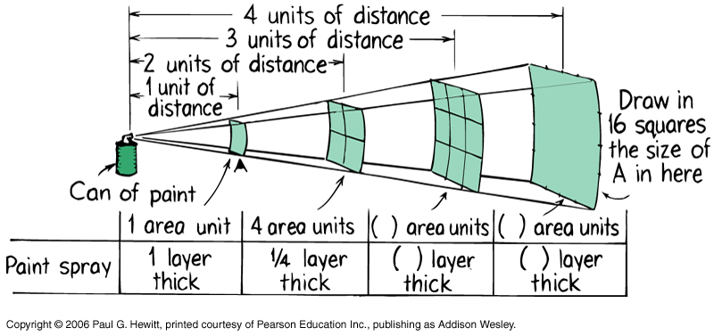
Distance-dependence of gravity
Inverse-square law: F ~ 1/d²
Compare with paint-spray burst out from a can: the thickness of the paint varies in the same inverse-square way i.e. if 1-layer thick at 1m, then is ¼ layers thick at 2 m etc.

Slide 6
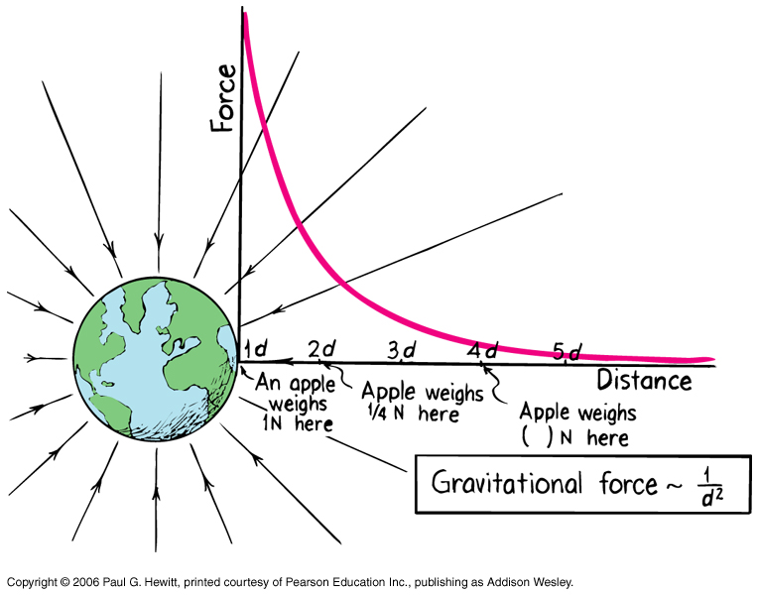
Distance-dependence continued…
Notes (1) d = distance between the center of masses of the objects.
So when one of the objects is earth, then the relevant distance
d = radius of the earth + distance of other object from earth’s surface.
6.4 x 10⁶ m
(2) Even very very far from earth, its gravitational force is never actually zero, but it does decrease rapidly and forces from other more nearby objects would overwhelm the grav force from earth.

Slide 7
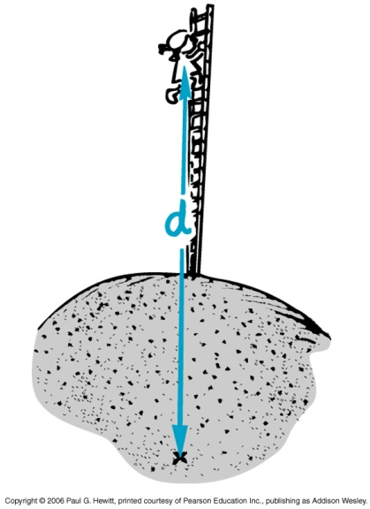
Questions
(1) What is the force of earth’s gravity on a 1-kg object at the surface of the earth? What do we commonly call this force?
F = G m_{earth} m_{1kg}/d_{earth}²
= (6.67 x 10⁻¹¹ )(6 x 10²⁴ kg) (1kg)/(6.4 x 10⁶ m)² = 9.8 N
The force of gravity on an object is how we defined its weight.
i.e. g = 9.8 N/kg that we defined earlier, is just g = Gm_{earth}/R_{earth}² .
Ordinary distances on earth are so small c.f. radius of earth, that their distance to earth’s center is ~ R_{earth}, so grav force on them is just mg.
(2) If you climbed to the top of Mount Everest (height 8850 m), how much less would you weigh? Assume you eat on the way so that your mass remains fixed.
At top of Everest, d = 6.4 x 10⁶ + 8850 = 6.40885 x 10⁶ m
So, the force is (6.4/6.40885)² = 0.997 as much
eg. If you weigh 200-lb here, then you’ll weigh 199.4-lb on Mt Everest.

Slide 8
Clicker Question
Notes:
Ch 9-1

Slide 9
Question:
Jupiter is about 300 times as massive as the earth but with radius about 11 as much as that of earth. On which would an apple weigh more ?
G m_{p} m_{a}
where m_{p} is mass of the planet and m_{a} is mass of the apple
F =
d ²
So on Jupiter F_{on apple} = G m_{a}(300m_{E)}/(11R_{E})²
= (300/11²)G m_{a}m_{E}/R_{E}²
= 2.6 F_{on apple} on Earth
→ Apple weighs 2.6 times more on Jupiter than on Earth
where m_{E} and R_{E} are the mass and radius of Earth

Slide 10
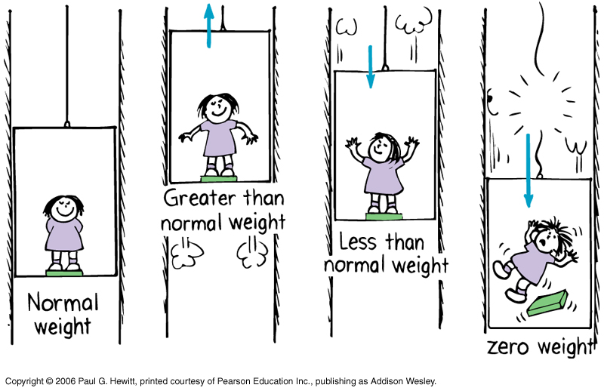
Weight and Weightlessness
Earlier, we defined weight as force due to gravity, mg.
But if we accelerate, we may “feel” heavier or lighter – eg. in an elevator:
Your “apparent weight” depends on your acceleration
If the elevator accelerates upwards, any scales you are standing on will read a higher weight and you feel heavier → larger “apparent weight”; if accelerates downwards, they read a lower weight and you feel lighter→ less “apparent weight”.

Slide 11
Weight/weightless continued…
The scales measure how much a spring inside is compressed – i.e. how much force it must exert to balance (or support) the force you are exerting on it.
We will now define apparent weight to measure this instead --
Define apparent weight = force exerted against a supporting surface or a weighing scale.
(Note: your textbook calls “apparent weight” just weight at this point!)
Then, you are as heavy as you feel ! (c.f. elevator again)

Slide 12
Weightlessness
If the elevator is in free fall (cable broken), then your apparent weight is zero, since there is no support force. “Weightless”.
Gravity is still acting on you, causing downward acc. but not felt as weight.
Same weightlessness for astronaut in orbit – he still has gravity acting on him, but since every object in his shuttle (including any bathroom scale) is falling around the earth with him, he is not supported by anything, no compression in the scales etc.

Slide 13
Clicker Question

Slide 14
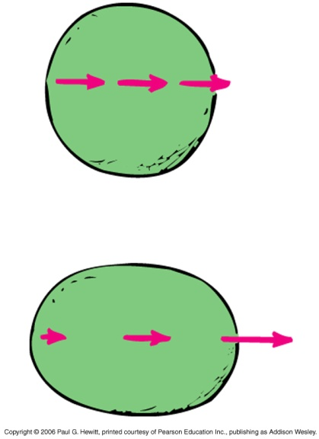
Ocean Tides
Caused by differences in the gravitational pull of the moon on the earth on opposite sides of the earth.
Moon’s pull is stronger on the side of the earth that it is closest to; weakest on the opposite side, because F decreases with distance.
Why does this result in two high-tides (and two low-tides) every day? Because when the moon is either closest or farthest away, you get a maximum bulge:
Imagine earth to be a ball of jello.
If moon’s force was equal at every point, then it all accelerates together towards moon.
But moon’s force is actually more like arrows here: so ball gets elongated – both sides effectively bulge.
(moon over here somewhere)

Slide 15
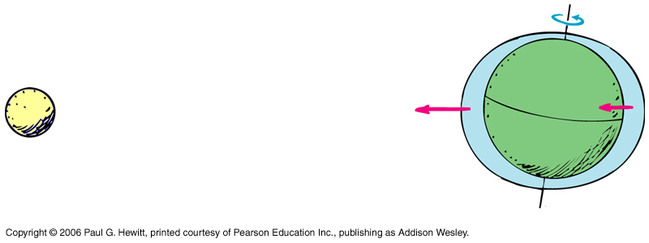
Tides continued
So, relative to the moon, the tidal bulges remain fixed while Earth spins beneath – mostly it is the oceans that bulge out equally on opposite sides, on average nearly 1-m above.
Note: the moon’s pull on the earth is equal and opposite to the earth’s gravitational pull on the moon. Centripetal force.
If earth was infinitely more massive than moon, moon would rotate about the earth.
Actually, they rotate about their CM which is a point inside earth, about ¾ the radius of the earth.

Slide 16
More on tides…
Since earth spins once a day, any point on earth has two high tides and two low tides (on average, 1-m below average) a day.
If moon was not orbiting, then the high-low tide separation would be ¼ day, ie. 6 hours.
But since while the earth spins, the moon moves in its orbit, it turns out the moon returns to same point in the sky every 24 hours and 50 minutes – ¼ of this is what determines the high-low-tide time difference.
This is why high tide is not at the same time every day
Why are there no tides in lakes?
  Because lakes are localized; no part of the lake is a lot closer to the moon than any other part, so no big differences in moon’s pull in a lake, as opposed to the oceans which span the globe…
Note also that due to the earth’s tilt, the two high-tides are not equally high.

Slide 17
Clicker Question

Slide 18
Question: How about tides due to the sun?
The sun’s gravitational force on Earth is 180 times as large as that of the
moon’s pull on Earth. So, what about ocean tides due to the sun??
Why are these not 180 times as strong as those due to the moon?
Because tides happen due to differences in grav pulls on one side of earth c.f. other side.
Because the sun is so far away, the 1/d² factor flattens out, so the difference in its F at opposite points on the earth is very small: 0.017 %
Whereas for the moon, the difference in its grav F at opposite points on the earth is much larger: 6.7 %
Still, 180 is a big factor in the actual size of the force – and means that despite the tiny % difference, there are tides due to the sun, which are about half as high as those due to the moon
(180 x 0.017 % = 3 %, which is about half of 6.7 %)

Slide 19
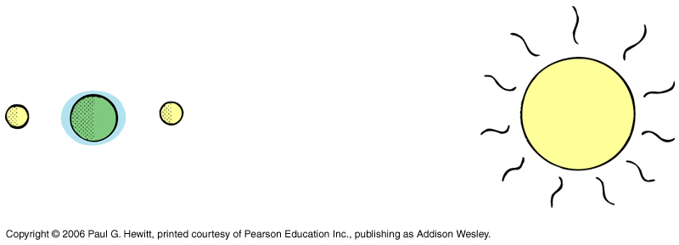
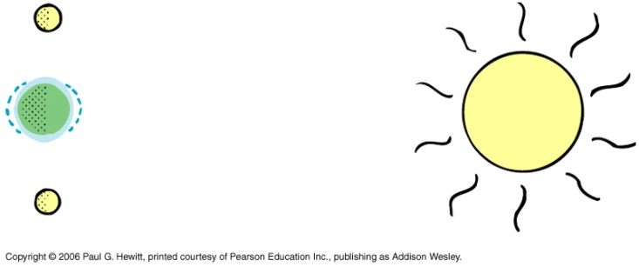
Spring vs Neap tides
Get increased (spring) or decreased (neap) tide size due to sun and moon “collaboration”:
When sun, moon are in a line with the earth, tides due to each coincide → high-tides are higher and low tides are lower than average -- Spring tide (nothing to do with the season).
At full moon or new moon.
When lines to the moon and sun are at right angles, then high tide due to one occurs at low tide due to other smaller than average high tides – Neap tide (nothing to do with your instructor)
At time of half-moon.

Slide 20
Tides in the earth:
Earth is molten liquid covered by a thin, solid crust → earth also experiences high and low tides! High tides are about ¼ m.
This is why earthquakes, volcanic eruptions are more likely near a full or new moon (spring tide time).
Tides in the atmosphere:
Air also experiences tides, but we don’t feel them as we are at the bottom of the atmosphere.
Gives rise to magnetic tides in the upper atmosphere: ionosphere has many charged particles, so tidal effects lead to electric currents that change earth’s magnetic field.

Slide 21
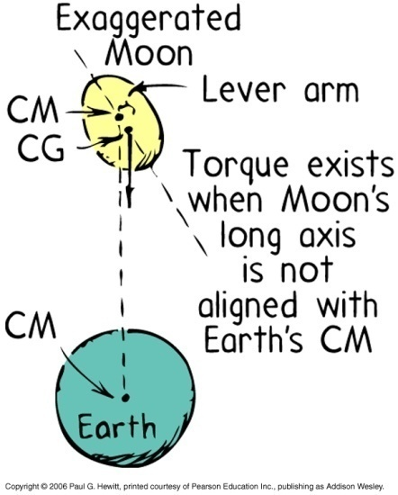
How about on the moon? Moon-tides
Moon also has two tidal bulges, making it a football shape, with long axis pointed towards earth.
But these bulges do not move, because the same side of the moon always faces the earth: moon spins on its axis at the same rate at its orbital motion around earth.
DEMO: you be the moon and try orbiting a fixed friend (earth), always keeping your face towards him/her – you find that you have to spin to do this!
(Ages ago, it spun much faster, but then slowed down, and got locked into this synchronous orbit because of a torque action from the earth: We won’t study this effect in this course, but it is interesting:
As a result, on earth we only see one side of the moon.)

Slide 22
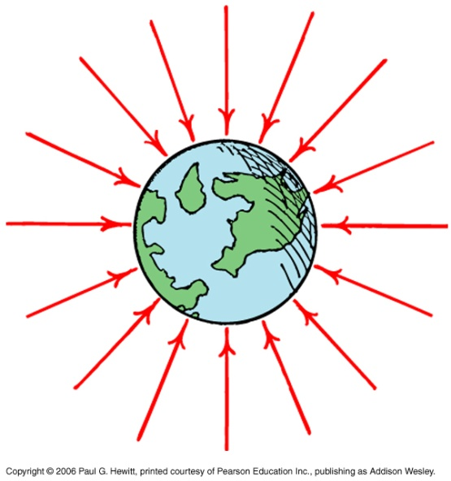
Gravitational Fields
Gravitational force acts at a distance – i.e. the objects do not need to touch each other.
We can regard them as interacting with the gravitational field of the other: think of this existing in the space around an object, so another object in this space feels a force towards it.
Field lines have arrows indicating direction of force at that point, and are closer together when the field is strongest.
The gravitational field is a vector, same direction as the force, and strength is the force on a mass m, divided by that m:
g = F/m , units are N/kg

Slide 23
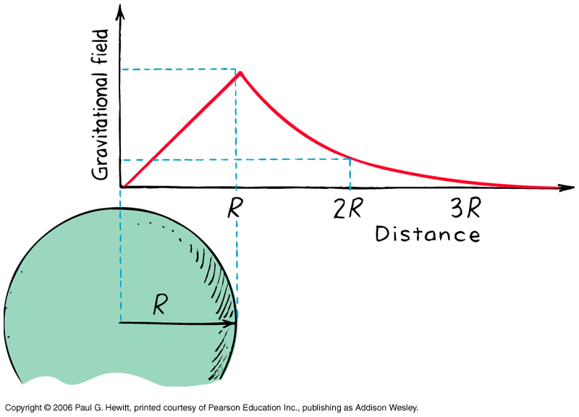
(Gravitational field inside a planet)
We will not cover this much or examine this in this course.
The only thing we will note is that the field increases linearly inside the planet (and falls off in the usual inverse-square way outside). It is zero right in the middle of the planet.
Read about it if you are interested!!

Slide 24
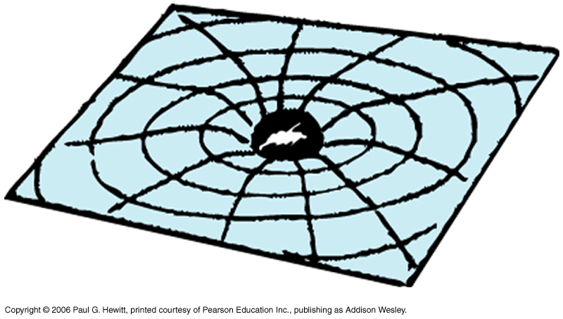
(A very little on Einstein’s Theory of Gravitation)
1900’s: Einstein’s theory of general relativity involves curved four-dimensional space-time
Replace bodies producing gravitational fields with warped space-time.
Not examinable in this course…
Notes:
OMIT?

Slide 25
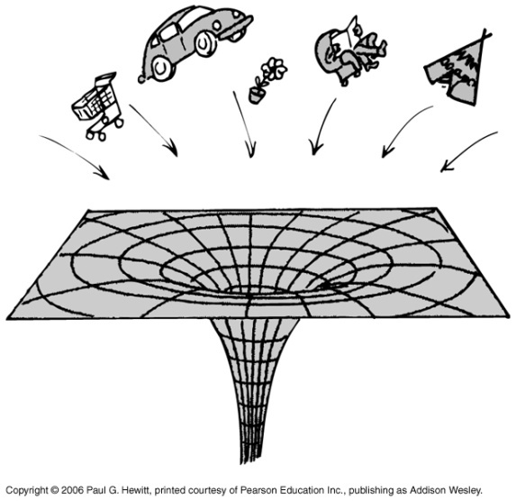
A little on Black Holes
Because grav force increases with decreasing distance, then if a massive object somehow shrinks tremendously (keeping amount of mass fixed) the grav force on its surface gets tremendously stronger.
Happens for massive stars (> 1.5 of mass of our sun) when they have burnt their fuel – the stuff left condenses into an extremely dense object (neutron star) which, if large enough, continues to shrink because of its gravity.
Consider an object on the surface of such a star – it feels increasing grav force, to the point that it can never leave it.
i.e. the speed required to overcome the grav force becomes faster than the speed of light, and no object can have such a speed. Called a black hole.
This means no object, not even light, can escape
from a black hole. Anything coming near gets sucked in
and destroyed (although its mass, ang mom, charge are
preserved)

Slide 26
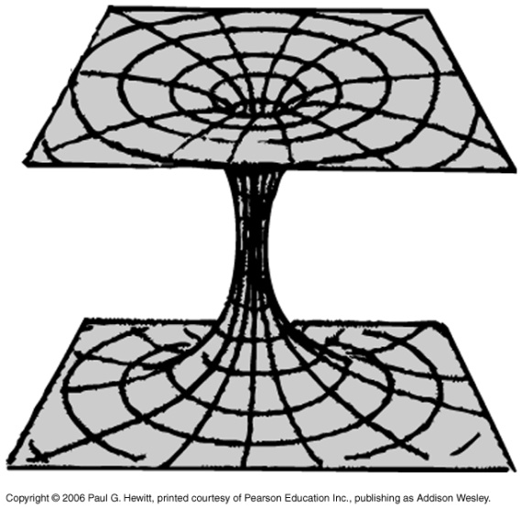
Black holes continued…
Since black holes are invisible, how do we know they exist?
By their grav. influence on neighboring stars – e.g. binary star systems, where have one luminous star and a black-hole orbiting each other.
Other experimental evidence indicates massive black holes at the center of many galaxies e.g. in old ones, stars circle in a huge grav field, with an “empty-looking” center.
Galactic black holes have masses 10⁶ – 10⁹ times that of our sun.
Related, but still speculative, entity: wormhole
Instead of collapsing to a point, it opens out again in another part of the universe – time travel…
But still speculative (unlike black holes)

Slide 27
Clicker Question
Notes:
Ch 9-3

