Slide 1
Today:
Finish a couple of slides Ch 23
Chapter 24: Magnetism

Slide 2
Magnetism
Magnetic Forces
What is the origin of the magnetic force? Moving charged particles (more later). E.g. Orbiting electrons in the atoms making up a magnet.
Stationary charged particle – produces electric field
Moving charged particle – produces both an electric field and a magnetic field.
Actually, electrical and magnetic forces are intimately related through relativistic considerations – different manifestations of “electromagnetism”.

Slide 3
Magnetic Poles
Magnetic poles – from which magnetic forces emanate.
Two types: north and south
Every magnet has both a north and a south pole
Like poles repel each other; unlike poles attract.
Simple compass:
Suspend bar magnet from its center by a piece of string. Convention is that the north pole points northward; south pole points southward.
This means that the Earth’s “north pole” is actually a magnetic south pole! And vice-versa.
Eg. Bar magnet
N S

Slide 4
Magnetic Poles cont.
Another type: Horseshoe magnet
Fridge magnets – have narrow alternating N and S strips. Strong field near the magnet but field decays quickly with distance since N and S fields cancel.
Magnetic poles cannot be isolated. (Big difference with electric charge) e.g. if break bar magnet in two, each half behaves as complete magnet, each with N and S poles. Even when it’s one atom thick! No magnetic monopoles.

Slide 5
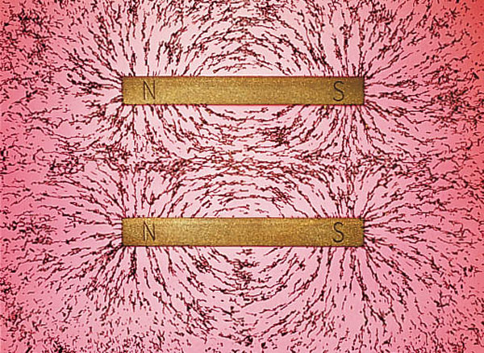
Magnetic Fields
Iron filings sprinkled around bar magnet align with the magnetic field.
(c.f. electric field lines earlier)
Field is stronger where lines are more dense
Actually magnetic field lines form closed loops – they continue inside the magnet (not shown in pic)
Eg. Two bar magnets with opposite poles at same end
Eg. Two bar magnets with like poles at same end.
Notes:
Need figure?

Slide 6
Clicker Question

Slide 7
Where is the motion that makes a stationary bar magnet magnetic?
The moving charges are the electrons – undergoing two kinds of constant motion:
(i) spin, like “tops” (although, really need quantum mechanics to describe this)
(ii) orbit (revolve) about nucleus
Usually spin is the significant contribution
Every spinning electron is a tiny magnet. Net magnetism comes from sum of fields from every electron.
Non-magnetic materials: consists of pairs of electrons spinning in opposite directions, so their fields cancel each other, and there is no net magnetic field.
Magnetic materials: eg iron, nickel, cobalt, not all spins are cancelled out. Eg. each iron atom has 4 electrons whose spin magnetism isn’t cancelled.

Slide 8
Magnetic Domains and Making Magnets
Magnetic field of an individual iron atom is so strong, that it makes neighboring atoms line up - get clusters of billions of aligned atoms, called magnetic domains.
Also, domains themselves can align with each other.
But the domains are generally in independent, random orientations – so a common piece of iron is not a magnet.
Only when they align with each other, does the piece of iron become a magnet.
This is how permanent magnets can be made! Tapping the iron helps align any stubborn domains.
Can make them align by bringing a (permanent) magnet nearby – if this magnet is strong enough, then when you separate them again, the iron piece may retain the alignment, and so be magnetic.
But if not strong enough, then on removing the permanent magnet, the domains in the iron piece thermally move back to a random arrangement.
Another way to make magnet: stroke iron piece with magnet – aligns domains.

Slide 9
Here are the stages in magnetizing a piece of iron:

Slide 10
Clicker Question

Slide 11
Question: Place an unmagnetized piece of iron in a magnetic field (eg iron filings near a magnet). Why is it attracted to the magnet?
Because the field brings domains of the iron piece into alignment. So the iron piece develops a N and S pole. The induced N is then attracted to the permanent magnet’s S, etc.
(c.f. concept of polarization in electric case)
In fact, most iron-containing objects around you are magnetized to some extent – largely induced by Earth’s magnetic field.

Slide 12
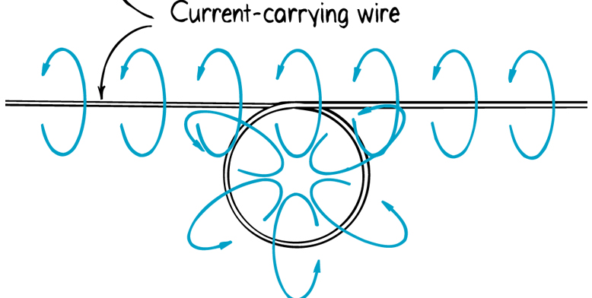
Electric currents and magnetic fields
Current = moving charges, so current produces magnetic field.
Eg: put compasses around current-carrying wire: needles align circularly – Magnetic field lines form circ. loops around wire.
If reverse direction of current, all needles reverse direction
If bend wire around into a loop, field loops get bunched in the middle, all pointing in the same direction there:
Electromagnet = current-carrying coil of wire.

Slide 13
Electromagnets cont.
Can increase strength of field by
- increasing current
- using several overlapping coils (intensity grows as # of coils)
- putting an iron core within the coil (mag domains of iron induced into alignment and so add to the field)
Eg. Used to lift cars in junkyards.
Limiting factors – heating from large currents (due to electrical resistance)
-- saturation of domains (i.e. all aligned) in iron core
Most powerful use superconductors (and no iron core) since can conduct large currents (almost zero resistance)…maglev…

Slide 14
Clicker Question

Slide 15
Magnetic force on moving charged particles
When a charge is moving, it will experience a force if it is in a magnetic field.
Strength of force depends on
- strength of field
- charge’s velocity (faster is stronger. Note, no force if stationary!)
- how large the charge is (larger is stronger. Note, no force if uncharged!)
- relative direction of charge’s velocity to the field - strongest if moving perpendicular to field. Note, no force if its moving parallel to the field!
Direction of force is perpendicular to both the magnetic field, and to the particle’s velocity.

Slide 16
Magnetic force on moving charged particles cont.
Eg:
Electron beam is deflected upwards.
Notes:
If protons instead, force downwards.
If electrons, but moving in opposite dir, force downwards.
Notes:
Make clicker qn on this

Slide 17
Magnetic force on moving charges cont.
Note big difference with grav force and electrical force:
- magnetic force does not act along the line joining the interacting objects; rather it is perpendicular to both field and the charge’s path.
This deflective action is used in (old style) TV’s
Cosmic rays: charged particles streaming in from the sun fortunately get deflected by the earth’s magnetic field lines (see more later)

Slide 18
Magnetic force on current-carrying wires
Current = moving charges, so current also experiences deflection in a magnetic field; wire gets pushed perpendicular to field:
Deflection direction is reversed when current direction is.
Note complementary property (related to 3rd law):
Recall a current-carrying wire has an associated magnetic field, so deflects a magnet.
Likewise, here a magnet deflects a current-carrying wire.

Slide 19
Clicker Question

Slide 20
Electric Meters
i.e. a current-detecting device.
Simplest: a magnet that is free to turn (ie a compass)
Next simplest: a compass in a coil of wires, so that magnetic field sensed by compass is increased:
So can detect very small currents – called a galvanometer
More common design for galvanometer -
Magnet held stationary. Many loops of wire, so more sensitive; rotates when current is flowing, and deflects a spring.
Can be calibrated to measure current (ammeter), or voltage (voltmeter).
Notes:
Start here after Thanksgiving.

Slide 21
Electric motors
Designed so that deflection makes a complete rotation (instead of partial, as in a galvanometer)
How ? Consider simplified motor:
Current on one side of the loop flows in the opposite direction to the current on the other side of loop. So, the two sides gets deflected in opposite directions, as shown; hence it turns.
After a half turn, the sides have reversed, so deflection is in the opposite direction – makes coil turns back.
To prevent this, reverse the direction of current every time coil makes a half rotation.
Then rotation is continuous, in one direction.
In most motors today, replace the magnet with an electromagnet, fed by the power source.

Slide 22
Earth’s magnetic field
Magnetic poles of Earth are actually about 1800 km from the geographic poles.
So compasses do not generally point to the true (i.e. geographical) north and true south.
Effect is called magnetic declination.
What gives Earth its bar-magnet -like property?
Somewhat unresolved problem.
Atoms are too hot to maintain fixed orientation. Instead, it is thought that in the molten part of earth, surrounding solid core, moving charges loop around, thus creating the earth’s magnetic field.
What is causing the currents? Also not completely understood. Maybe thermal energy from core giving convection currents.

Slide 23
More on Earth’s magnetic field
Unstable – it can diminish to zero, and then reverse direction. More than 20 such pole reversals have occurred in the past 5 million years! Next one expected within 2000 years.
Can detect from magnetization within Earth’s upper rock strata…see book for more on this…
Sun’s magnetic field also reverses regularly, every 22 years. (Related to droughts on earth?)
Smaller and faster fluctuations in Earth’s field are from varying ion winds in atmosphere. Ions created from solar ultraviolet and x-rays interacting with atmospheric atoms.

Slide 24
Cosmic rays
Are actually charged particles (protons, or other atomic nuclei), produced by sun, or other stars.
Travel at speeds close to the speed of light
Dangerous radiation for humans; also can mess up electronic instrumentation.
Earth’s magnetic field protects us from them by deflecting them back (previous picture, also next slide)
Some are trapped, spiralling back and forth along field lines, in two “van Allen radiation belts”:
Astronauts orbit well below the inner one.
Outer ring ~ 16 000 km over head. Mostly electrons, also protons; largely from sun.
Inner ring ~ 3200 km overhead. Mostly protons. Probably originated from earth.

Slide 25
Clicker Question

Slide 26
When ions dip into Earth’s atmosphere, get beautiful light shows from fluorescence: aurora borealis (northern hemisphere), and aurora australis (southern hemisphere)
Spaceflights try to avoid the belts, since hazardous to astronauts and instruments.
Although Earth’s field protects us on surface of earth from “primary” cosmic rays, we do get bombarded with “secondary” ones – when primary rays strike atomic nuclei high in atmosphere.
Greatest bombardment at the magnetic poles, because the rays come in parallel to the field lines so don’t get deflected as much as those coming in near equator, perpendicular to field.
Mid-latitudes, about 5 particles per square cm at sea-level!

Slide 27
Biomagnetism
Some animals have magnetite (iron oxide) domains in their bodies i.e. a built-in compass, allowing them to sense magnetic fields, and thus navigate!
Eg. Some bacteria, pigeons, wasps, monarch butterflies, sea turtles, bees…
Read book for more on this.

Slide 28
Clicker Question

