Slide 1
Today:
Finish Chapter 14: Magnetic Induction
Start Chapter 25: Light
Final Exam
Tue Dec 20, 11.30am—1.30pm
Cumulative, multiple-choice, 2-3 qns per chapter up to Ch 22, and 5-6 qns per chapter after that.
All questions you will have seen before on lecture slides, midterms, or review sessions (inc. Fri’s final review session)
Note: Teacher Evaluation Period has begun: please log in using Hunter netID and pwd:
Computer: www.hunter.cuny.edu/te
Smartphone: www.hunter.cuny.edu/mobilete

Slide 2
Light: preliminaries
Light is the only thing we actually see – e.g. When I “see” you, I am actually seeing light reflected off you.
Light is a transverse wave (recall earlier), whose origin is accelerating electrons, e.g. in the sun
Accelerating electrons not only can produce light, but also radio waves, microwaves, x-rays…. Grouped together as electromagnetic waves.
Different types of electromagnetic waves differ in their frequency (and wavelength): light is just a small part of the electromagnetic spectrum with certain frequency range

Slide 3
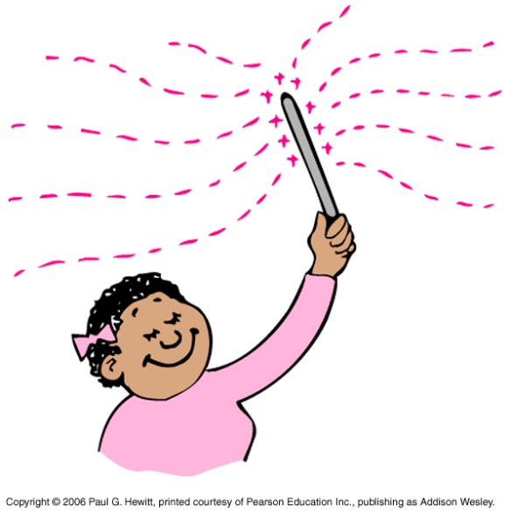
Electromagnetic Waves
Origin is accelerating electron: how?
Consider shaking a charged rod back and forth in space
i.e. You create a current (= moving charges) that varies in time, i.e. a changing electric field in space and time.
Recall from last chapter: a changing electric field creates a changing magnetic field, that in turn creates a changing electric field, that in turn…
i.e. a propagating disturbance
The vibrating (oscillating) electric and magnetic fields regenerate each other - this is the electromagnetic (EM) wave.

Slide 4
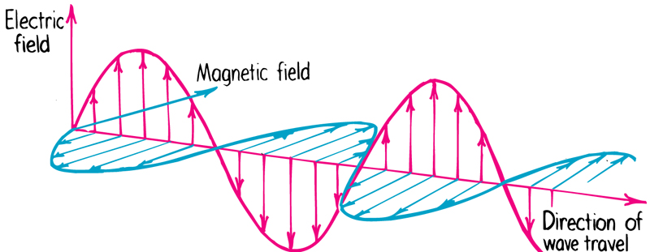
Electromagnetic Waves cont.
The EM wave moves outwards (emanates) from the vibrating charge.

Slide 5
Electromagnetic Wave Velocity
An electromagnetic wave travels at one constant speed through space. Why?
Inherently due to wave nature (e.g. objects like spacecrafts can change speed, and go at different constant speeds); specifically, induction and energy conservation:
Recall (last chap): the strength of the induced fields depends on the rate of change of the field that created it.
So, if light traveled slower, then its electric field would change slower, so would generate a weaker magnetic field, that in turn generates a weaker electric field, etc→ wave dies out.
Similarly, if light sped up, would get stronger fields, with ever-increasing energy.
Both cases violate energy conservation.

Slide 6
Electromagnetic Wave Velocity cont.
Then what is the critical speed at which mutual induction sustains itself? Maxwell calculated this:
300 000 km/s = c
i.e. 3 x 10⁸ m/s
This is the speed in vacuum, and about the same in air. Slower in different media (see later)

Slide 7
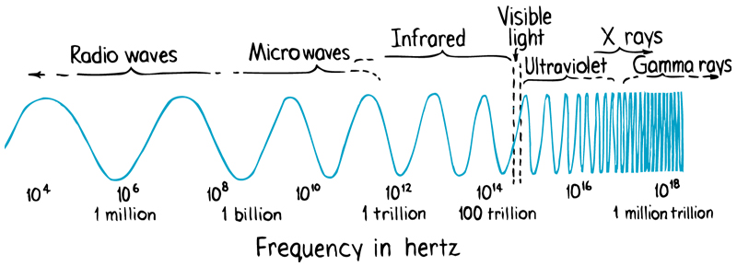
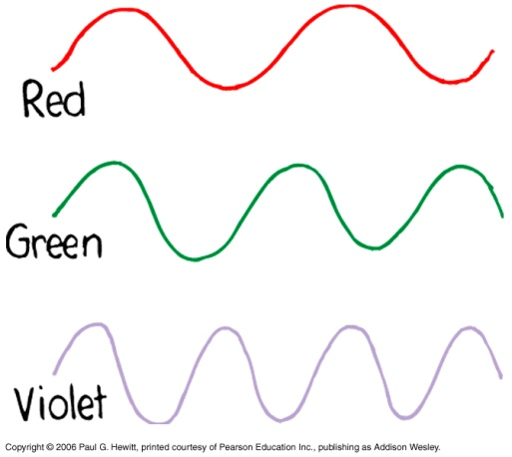
The Electromagnetic Spectrum
In vacuum, all electromagnetic waves move at the same speed c, but differ in their frequency (and wavelength).
recall speed c = f λ
Visible light: 4.3 x 10¹⁴ Hz to 7 x 10¹⁴ Hz
i.e. red is at the low-freq end of light (next lowest is infrared)
violet is the high-freq end (next highest is ultraviolet)
and long-wavelength
short wavelength

Slide 8
Clicker Question

Slide 9
Clicker Question

Slide 10
The electromagnetic spectrum cont.
Recall Ch 18 on waves: frequency of wave = freq of vibrating source.
Applies to EM waves too, where source is oscillating electrons
Note that EM waves are everywhere! Not just in air, but in interplanetary “empty space” - actually a dense sea of radiation. Vibrating electrons in sun put out EM waves of frequencies across the whole spectrum.
Any body at any temperature other than absolute zero, have electrons that vibrate and (re-)emit in response to the EM radiation that permeates us, even if very low frequency.

Slide 11
Question
A helium-neon laser emits light of wavelength 633 nanometers (nm). What frequency is this? What color ?
Use c = f λ, so f = c/λ
= (3 x 10⁸ m/s)/(633 x 10⁻⁹ m)
= 4.74 x 10¹⁴ Hz
i.e. red

Slide 12
Clicker Question

Slide 13
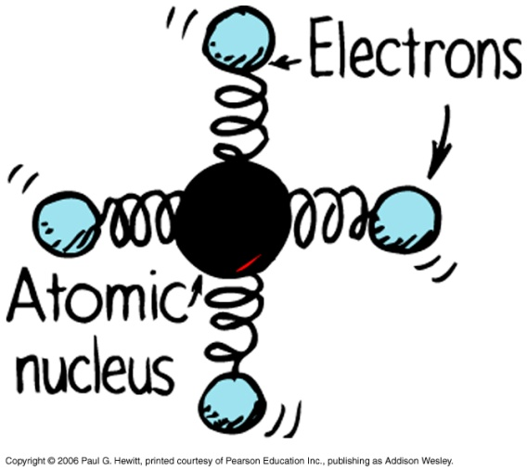
Transparent materials
Simple model of atom: think of electrons attached to nucleus with springs. Light makes these springs oscillate.
Different atoms/molecules have different “spring strengths” - so different natural frequencies.
If this natural freq = that of impinging light, resonance occurs (recall ch 20) i.e. vibrations of electrons build up to high amplitudes, electrons hold on to the energy for “long” times, while passing it to other atoms via collisions, finally transferred to heat. Not transparent, i.e opaque
So materials that are opaque to visible light, have natural frequencies in the range of visible light.

Slide 14
Transparent materials cont.
Glass is transparent: its natural freqs are higher, in the ultraviolet range. So glass is not transparent to ultraviolet.
But is transparent to lower freqs i.e. visible spectrum.
What happens in this off-resonance case?
Atoms are forced into vibration but at less amplitude, so don’t hold on to the energy long enough to transfer much to other atoms through collisions. Less is transferred to heat; instead vibrating electrons re-emit it as light at same frequency of the impinging light. (see more next slides)
Infrared waves – frequencies lower than visible – can force vibrations of atoms/molecules as well as electrons in glass. Increases internal energy and temperature of glass. Often called heat waves.

Slide 15
Clicker Question

Slide 16
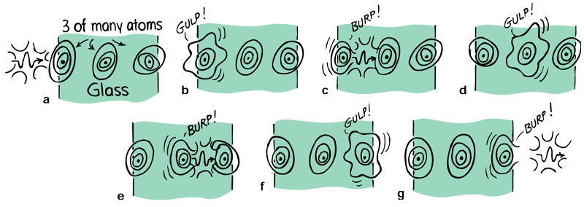
Transparent materials cont.
So: Light-transparent materials (like glass) have natural frequencies that don’t coincide with those of light. The atoms re-emit after absorbing.
This re-emission is time-delayed:
This leads to speed of light being different in different media:
In vacuum, it’s c
In air, only slightly less than c
In water, it’s 0.75c
In glass, 0.67c (but depends on type of glass)
When light emerges back into air, it travels again at original c

Slide 17
Questions
Why in the sunlight is a black tar road hotter to the touch than a pane of window glass?
Sunlight is absorbed and turned to internal energy in the road surface, but transmitted through the glass to somewhere else.
Can you get sunburned through a glass window?
Glass is opaque to ultraviolet light, so won’t transmit it, so you won’t get sunburned (although you might get hot! as light in the visible-range is transmitted and then you absorb it).

Slide 18
Opaque materials
Have natural frequencies in the visible range, E.g. books, you, tables, metals…
So, they absorb light without re-emitting it.
Light energy goes into random kinetic energy, i.e. heat.
Usually, not all the frequencies in the visible light spectrum are resonant - those that aren’t, get reflected: this gives the object color (see much more next chapter)

Slide 19
Some cases of interest:
Earth’s atmosphere – transparent to some UV, all visible, some infrared. But is (thankfully) opaque to high UV.
- the small amount of UV that does get through causes dangerous sunburn.
- clouds are semi-transparent to UV, so can still get sunburned on a cloudy day.
Water – transparent in the visible.
- This explains why objects look darker when wet:
Light is absorbed and re-emitted, bouncing around inside wet region; each bounce loses some energy to material. So less light enters your eye – looks darker.

Slide 20
Shadows
A thin beam of light is called a ray.
Shadow = region where light rays cannot reach e.g. caused by an obstacle in the path of the light.
Sharp shadows are from large far-away light source, or from a small nearby one.
Blurry shadows – from large nearby source. If too big, no shadow.
E.g. Move a pen from near the LCD projector (or a light bulb) to further away – shadow on screen (or wall) gets sharper.

Slide 21
Shadows cont.
Question: Why is there no definite shadow of your hand when you hold it high above your desk?
Because of the many different light sources in the room - the shadow cast by one source is illuminated by another light source.
Umbra = total shadow; penumbra = partial shadow – how do we get penumbras?
e.g. where some of the light is blocked and light from another source fills it in. Or when light from a large source is only partly blocked.

Slide 22
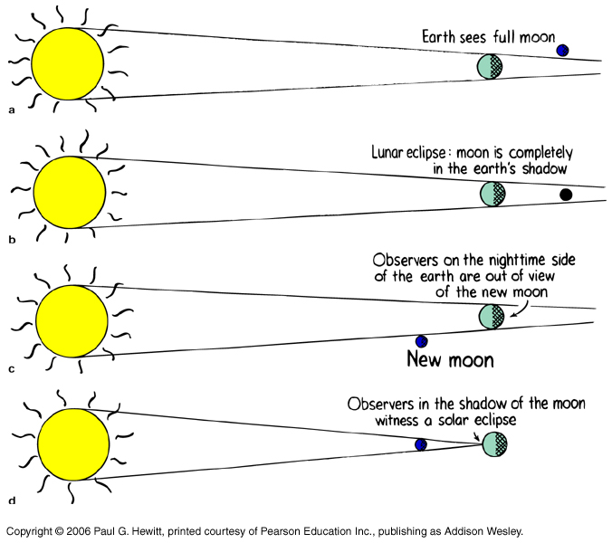
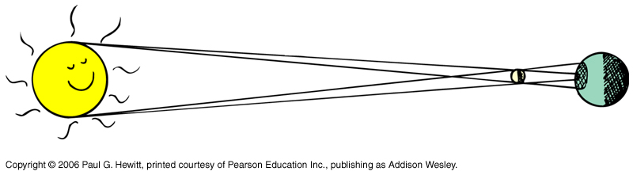
Shadows of the earth and moon
Both earth and moon cast shadows when sunlight incident
When one passes into the shadow of the other – eclipse:
lunar eclipse
Demonstrates umbra vs penumbra:
Sun is so big that some parts of earth are in the umbra - see complete darkness - whereas others are in penumbra – see partial eclipse (crescent)
solar eclipse

Slide 23
Questions
Why do you not cast a shadow on the ground on an overcast day?
A relatively small light and distant source such as the sun casts a relatively sharp shadow. On an overcast day, the primary sun is blocked and the whole sky (the “secondary” light source), illuminates you. The source is now so big that no shadow is seen.
Lunar eclipses are always eclipses of a full moon. i.e moon is full just before and after the earth’s shadow passes over it. Why? Can we have a lunar eclipse when we have a half-moon?
Lunar eclipse is perfect alignment of Sun-Earth-Moon. Not-quite-perfect alignment gives Earth observers a full view of the moon since the sunny-side of the moon is facing the night-side of the Earth.
We cannot have a half-moon eclipse, since at halfmoon, the lines from Earth to moon and from Earth to sun are at right angles, so shadow of the Earth does not fall on the moon.

Slide 24
Clicker Question

Slide 25
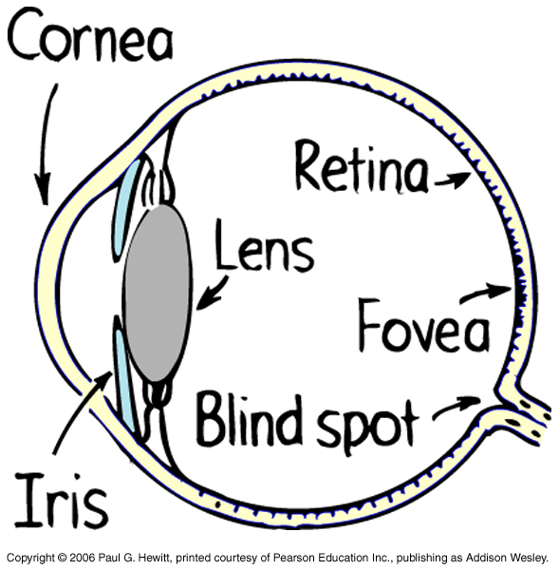
The Eye
is what we detect light with:
Lens does most of the bending to focus images onto the retina.
Cornea -transparent cover, through which light enters and bends to enter pupil…
Retina is very sensitive to light, made of “antennae” called rods and cones (see next slide). Not uniform.
Fovea is most concentrated – so images most distinct here.
Pupil
(aperture in iris)
Blind spot – no rods and cones - optic nerve exits here. Try the fun expt (26.15) in your book !! Image disappears if focused on blind spot.

Slide 26
More on the eye
Rods - mostly towards periphery of retina
- sensitive to light or dark but not color.
Cones - 3 types, depending on whether they detect high-freq, intermediate-freq, or low-freq.
- denser towards the fovea, and most dense there.
- detect color
- need more energy than rods before they “fire” an impulse
So, cones don’t detect low intensities, e.g. at night, it's your rods that do the seeing.
If want to see detail and color of object, focus it on the fovea.
In contrast, at periphery of vision, can’t tell what color objects are (…next slide)

Slide 27
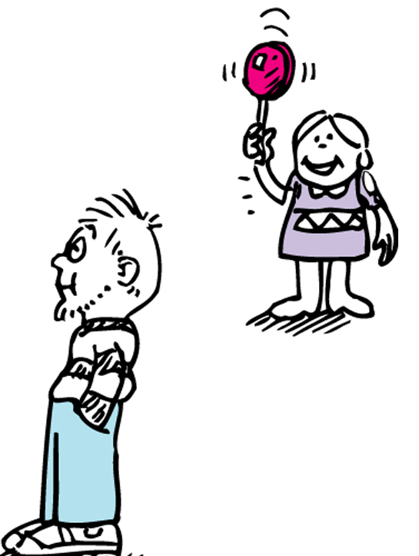
More on the eye
Eg. DEMO for homework! Get a friend to jiggle colored objects at side, where you can only just see them – you see them moving, but can’t tell what color they are!
Periphery of eye is very sensitive to motion – makes sense from evolutionary point of view.

Slide 28
There’s some more about the eye in your book, that makes for interesting reading, but won’t be covered or examinable in this course.
E.g. How pupil dilates when we are sense something that pleases us, and contracts if we find something repugnant!
E.g. “Lateral Inhibition” effect – which tends to make us notice boundaries….
E.g. Optical illusions – consider the illusions in Fig. 26.21 in your book!

Slide 29
Clicker Question

